Slide 1
Quick Sort

Slide 2
QuickSort Design
Follows the divide-and-conquer paradigm.
Divide: Partition (separate) the array A[p..r] into two (possibly empty) subarrays A[p..q–1] and A[q+1..r].
Each element in A[p..q–1] <= A[q].
A[q] < each element in A[q+1..r].
Index q is computed as part of the partitioning procedure.
Conquer: Sort the two subarrays by recursive calls to quicksort.
Combine: The subarrays are sorted in place – no work is needed to combine them.
How do the divide and combine steps of quicksort compare with those of merge sort?

Slide 3
Pseudocode
Quicksort(A, p, r)
if p < r then
q := Partition(A, p, r);
Quicksort(A, p, q – 1);
Quicksort(A, q + 1, r)
Partition(A, p, r)
x:= A[r]
i=p – 1;
for j := p to r – 1 do
if A[j] ≤ x then
i := i + 1;
A[i] ↔ A[j]
A[i + 1] ↔ A[r];
return i + 1
A[p..r]
5
A[p..q – 1]
A[q+1..r]
Partition
5
≤ 5
> 5

Slide 4
Example
Position of I and j after of line 3
p r
initially: 2 5 8 3 9 4 1 7 10 6 note: pivot (x) = 6
i j
next iteration: 2 5 8 3 9 4 1 7 10 6
i j
next iteration: 2 5 8 3 9 4 1 7 10 6
i j
next iteration: 2 5 8 3 9 4 1 7 10 6
i j
next iteration: 2 5 3 8 9 4 1 7 10 6
i j
Partition(A, p, r)
1 x:= A[r]
2 i=p – 1;
3 for j := p to r – 1 do
4 if A[j] ≤ x then
5 i := i + 1;
6 A[i] ↔ A[j]
7 A[i + 1] ↔ A[r];
8 return i + 1

Slide 5
Example (Continued)
next iteration: 2 5 3 8 9 4 1 7 10 6
i j
next iteration: 2 5 3 4 9 8 1 7 10 6
i j
next iteration: 2 5 3 4 1 8 9 7 10 6
i j
next iteration: 2 5 3 4 1 8 9 7 10 6
i j
after final swap: 2 5 3 4 1 6 9 7 10 8
i j
Partition(A, p, r)
x:= A[r]
i=p – 1;
for j := p to r – 1 do
if A[j] ≤ x then
i := i + 1;
A[i] ↔ A[j]
A[i + 1] ↔ A[r];
return i + 1

Slide 6
Partitioning
Select the last element A[r] in the subarray A[p..r] as the pivot – the element around which to partition.
As the procedure executes, the array is partitioned into four (possibly empty) regions.
A[p..i ] — All entries in this region are <= pivot.
A[i+1..j – 1] — All entries in this region are > pivot.
A[r] = pivot.
A[j..r – 1] — Not known how they compare to pivot.
The above hold before each iteration of the for loop, and constitute a loop invariant.

Slide 7
Correctness of Partition
Use loop invariant.
Initialization:
Before first iteration
A[p..i] and A[i+1..j – 1] are empty – Conds. 1 and 2 are satisfied (trivially).
r is the index of the pivot
Cond. 3 is satisfied.
Maintenance:
Case 1: A[j] > x
Increment j only.
Loop Invariant is maintained.
Partition(A, p, r)
x:= A[r]
i=p – 1;
for j := p to r – 1 do
if A[j] ≤ x then
i := i + 1;
A[i] ↔ A[j]
A[i + 1] ↔ A[r];
return i + 1

Slide 8
Correctness of Partition
Case 1:
p
i
j
r
>x
x
≤ x
> x
p
i
j
r
x
≤ x
> x

Slide 9
Correctness of Partition
Case 2: A[j] ≤ x
Increment i
Swap A[i] and A[j]
Condition 1 is maintained.
Increment j
Condition 2 is maintained.
A[r] is unaltered.
Condition 3 is maintained.
p
i
j
r
≤ x
x
≤ x
> x
p
i
j
r
x
≤ x
> x

Slide 10
Correctness of Partition
Termination:
When the loop terminates, j = r, so all elements in A are partitioned into one of the three cases:
A[p..i] ≤ pivot
A[i+1..j – 1] > pivot
A[r] = pivot
The last two lines swap A[i+1] and A[r].
Pivot moves from the end of the array to between the two subarrays.
Thus, procedure partition correctly performs the divide step.

Slide 11
Quicksort Analysis
Assume that keys are random, uniformly distributed.
What is best case running time?
Recursion:
Partition splits array in two sub-arrays of size n/2
Quicksort each sub-array

Slide 12
Quicksort Analysis
Assume that keys are random, uniformly distributed.
What is best case running time?
Recursion:
Partition splits array in two sub-arrays of size n/2
Quicksort each sub-array
Depth of recursion tree?

Slide 13
Quicksort Analysis
Assume that keys are random, uniformly distributed.
What is best case running time?
Recursion:
Partition splits array in two sub-arrays of size n/2
Quicksort each sub-array
Depth of recursion tree? O(log₂n)

Slide 14
Quicksort Analysis
Assume that keys are random, uniformly distributed.
What is best case running time?
Recursion:
Partition splits array in two sub-arrays of size n/2
Quicksort each sub-array
Depth of recursion tree? O(log₂n)
Number of accesses in partition?

Slide 15
Quicksort Analysis
Assume that keys are random, uniformly distributed.
What is best case running time?
Recursion:
Partition splits array in two sub-arrays of size n/2
Quicksort each sub-array
Depth of recursion tree? O(log₂n)
Number of accesses in partition? O(n)

Slide 16
Quicksort Analysis
Assume that keys are random, uniformly distributed.
Recurrence relation T(n)=2T(n/2)+Θ(n)
Running time: O(n log₂n)

Slide 17
Quicksort Analysis
Assume that keys are random, uniformly distributed.
Best case running time: O(n log₂n)
Worst case running time?
Recursion:
Partition splits array in two sub-arrays:
one sub-array of size 0
the other sub-array of size n-1
Quicksort each sub-array
Depth of recursion tree?

Slide 18
Quicksort Analysis
Assume that keys are random, uniformly distributed.
Best case running time: O(n log₂n)
Worst case running time?
Recursion:
Partition splits array in two sub-arrays:
one sub-array of size 0
the other sub-array of size n-1
Quicksort each sub-array
Depth of recursion tree? O(n)

Slide 19
Quicksort Analysis
Assume that keys are random, uniformly distributed.
Best case running time: O(n log₂n)
Worst case running time?
Recursion:
Partition splits array in two sub-arrays:
one sub-array of size 0
the other sub-array of size n-1
Quicksort each sub-array
Depth of recursion tree? O(n)
Number of accesses per partition?

Slide 20
Quicksort Analysis
Assume that keys are random, uniformly distributed.
Best case running time: O(n log₂n)
Worst case running time?
Recursion:
Partition splits array in two sub-arrays:
one sub-array of size 0
the other sub-array of size n-1
Quicksort each sub-array
Depth of recursion tree? O(n)
Number of accesses per partition? O(n)

Slide 21
Quicksort Analysis
Assume that keys are random, uniformly distributed.
Recurrence Relation T(n)=T(n-1)+Θ(n)
Worst case running time: O(n²)

Slide 22
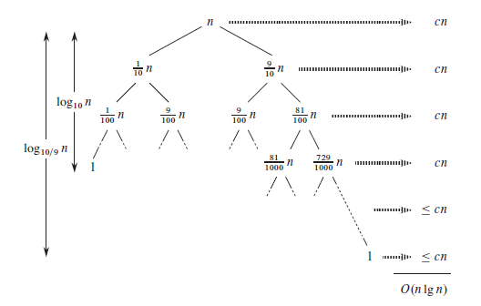
Quicksort Analysis
Balanced partitioning

Slide 23
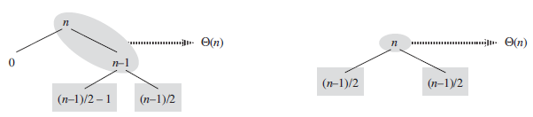
Quicksort Analysis
mix of “good” and “bad” splits

Slide 24
A randomized version of quicksort
RANDOMIZED-PARTITION (A, p, r)
i = RANDOM(p, r)
exchange A[r] with A[i]
return PARTITION(A, p, r)
RANDOMIZED-QUICKSORT(A,p,r)
if p < r
q = RANDOMIZED-PARTITION(A,p,r)
RANDOMIZED-QUICKSORT(A,p,q -1)
RANDOMIZED-QUICKSORT(A,q+ 1, r)

Slide 25
Expected running time
The running time of QUICKSORT is dominated by the time spent in the PARTITION procedure.
Each time the PARTITION procedure is called, it selects a pivot element, and this element is never included in any future recursive calls to QUICKSORT and PARTITION.
Thus, there can be at most n calls to PARTITION over the entire execution of the quicksort algorithm.

Slide 26
Expected Running Time of Partition
One call to PARTITION takes O(1) time plus an amount of time that is proportional to the number of iterations of the for loop in lines 3–6
if we can count the total number of times that line 4 is executed, we can bound the total time spent in the for loop during the entire execution of QUICKSORT.
Partition(A, p, r)
x:= A[r],
i=p – 1;
for j := p to r – 1 do
if A[j] ≤ x then
i := i + 1;
A[i] ↔ A[j]
A[i + 1] ↔ A[r];
return i + 1

Slide 27
Assume line 4 is executed for X times
We rename the elements of the array A as z₁, z₂, … , z_{n}, with z_{i} being the i^{th} smallest element.
We also define the set Zij = {z_{i ,} z_{i+1 , …,} z_{j} } to be the set of elements between z_{i} and z_{j} , inclusive.

Slide 28
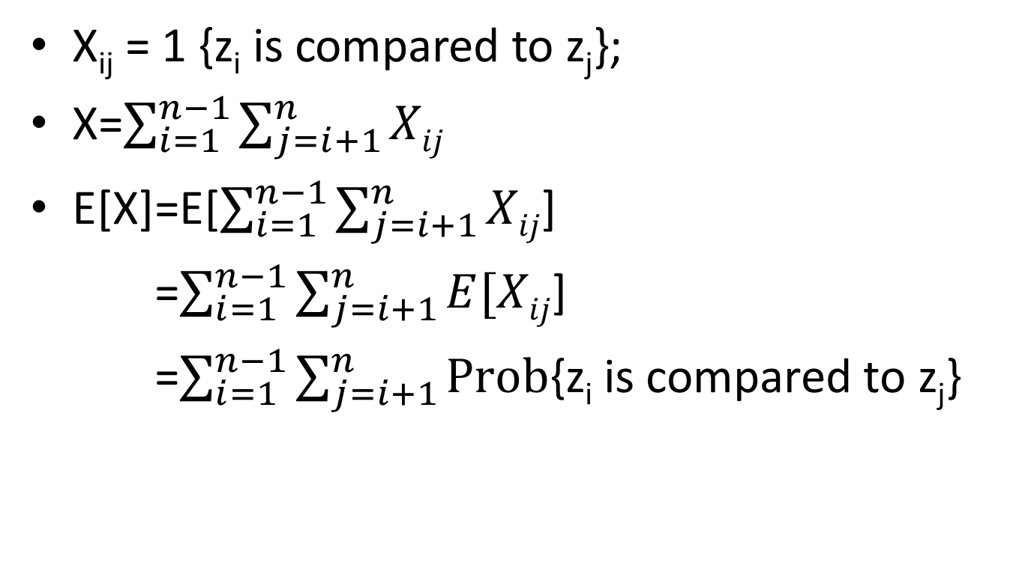
When does the algorithm compare z_{i} and z_{j} ?
X_{ij} = 1 {z_{i} is compared to z_{j}};
X=$\sum_{i=1}^{n−1}{\sum_{j=i+1}^{n}{Xij}}$
E[X]=E[$\sum_{i=1}^{n−1}{\sum_{j=i+1}^{n}{Xij}}$]
=$\sum_{i=1}^{n−1}{\sum_{j=i+1}^{n}{E[Xij}}$]
=$\sum_{i=1}^{n−1}{\sum_{j=i+1}^{n}{\text{Prob}\text{\{}\text{zi} \text{is} \text{compared} \text{to} \text{zj}\text{\}}}}$

Slide 29
once a pivot x is chosen with z_{i} < x < z_{j} , we know that z_{i} and z_{j} will not be compared at any subsequent time.
Pr {z_{i} is compared to z_{j} } = Pr {z_{i} or z_{j} is first pivot chosen from Z_{ij} }
= Pr {z_{i} is the first pivot chosen from Z_{ij} } + Pr {z_{j} is the first pivot chosen from Z_{ij} }
=1/(j-i+1)+ 1/(j-i+1)= 2/(j-i+1)

Slide 30
